Slide 1
List View Panels
November 28, 2014
Notes:
Guidewire training materials contain Guidewire proprietary information that is subject to confidentiality and non-disclosure agreements. You agree to use the information in this manual solely for the purpose of training to implement Guidewire software solutions. You also agree not to disclose the information in this manual to third parties or copy this manual without prior written consent from Guidewire. Guidewire training may be given only by Guidewire employees or certified Guidewire partners under the appropriate agreement with Guidewire.
<number>

Slide 2
Describe the functionality of list view panels
Create a new list view panel
Create and modify row iterator, row, and cell widgets
Reference list view panels
Notes:
<number>

Slide 3
List view panel fundamentals
Create list view panels
Reference list view panels
Notes:
<number>

Slide 4
Container widgets
PCF Element
Widget
Location
Atomic Widget
Container Widget
A container widget is a collection of atomic widgets and/or other container widgets
Organizes data and functionality into logical groups
Screen
Input Set
Card View Panel
Detail View Panel
List Detail Panel
List View Panel
Notes:
Container widgets hold other widgets. Each one can be defined either in its own file or as a child container within some other PCF element file.
Both Widget and Location are conceptual representations in this diagram. There are no <Widget /> or <Location /> elements. Similarly, both Atomic Widget and Container Widget are conceptual representations. There are no <Atomic Widget /> or <Container Widget /> elements.
The PCF object model is container-based. Each screen element is modeled as an object, which may contain other objects. The hierarchical structure simplifies the task of locating and modifying visual elements. Furthermore, each element can be declared as an independent and therefore reusable element.
<number>

Slide 5
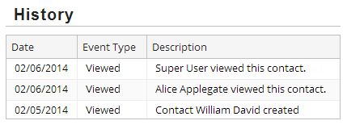
List view panels
ABContactHistoryLV
A list view panel is a container widget that often displays a set of rows that are related to one object or one query
Users can view and, in some cases, edit the data
Notes:
<number>

Slide 6
List view panel root objects
ABContact as root object
Container widgets often have one root object, a required variable
HistoryEntry
HistoryEntry
HistoryEntry
ABContactHistoryLV
Associated with a root object is often an array of related
Example: ABContact is the root object with an array of HistoryEntry objects
Notes:
<number>

Slide 7
List view panel anatomy
Row widget
Cell widget
Cell widget
Cell widget
Row widget defines the collection of columns to be iterated through
Cell widget defines an individual column to be included in that row
Row iterator produces output
Notes:
Row widgets organize the layout of the cells for an object instance when the row iterator is manipulating that instance. Row widgets do not perform any "navigation" within the collection of object instances. Adding a second row widget would not display two different objects when the page is rendered, but would arrange the cells for each instance across two rows. The generated markup for a row widget is a <TR> HTML tag.
Row iterators are discussed in the next slide.
<number>

Slide 8
Row iterator
An iterator is a widget that takes a set of items and performs the same set of actions for each member
A row iterator is an iterator for list view panels
For a set of objects (array or query result), a row iterator renders each object as one row of cells
HistoryEntry
HistoryEntry
HistoryEntry
ROW widget
CELL widget
CELL widget
CELL widget
Notes:
The PCF architecture has several different types of iterators, including:
Menu item iterators, which take a set of objects and generate one menu item for each.
Panel iterators, which take a set of objects and generate one panel (typically, one detail view) for each.
PolicyCenter coverage iterators, which take a set of coverages associated with a covered item (such as a vehicle) and generate one coverage input for each coverage.
<number>

Slide 9
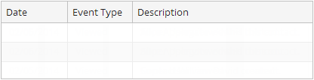
Row iterator: no objects processed
HistoryEntry
HistoryEntry
HistoryEntry
ROW widget
CELL widget
CELL widget
CELL widget
Notes:
The PCF architecture has several different types of iterators, including:
Menu item iterators, which take a set of objects and generate one menu item for each.
Panel iterators, which take a set of objects and generate one panel (typically, one detail view) for each.
PolicyCenter coverage iterators, which take a set of coverages associated with a covered item (such as a vehicle) and generate one coverage input for each coverage.
<number>

Slide 10
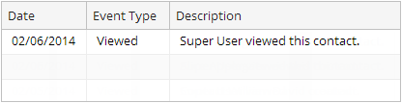
Row iterator: first object processed
Row
HistoryEntry
HistoryEntry
ROW widget
CELL widget
CELL widget
CELL widget
Notes:
The PCF architecture has several different types of iterators, including:
Menu item iterators, which take a set of objects and generate one menu item for each.
Panel iterators, which take a set of objects and generate one panel (typically, one detail view) for each.
PolicyCenter coverage iterators, which take a set of coverages associated with a covered item (such as a vehicle) and generate one coverage input for each coverage.
<number>

Slide 11
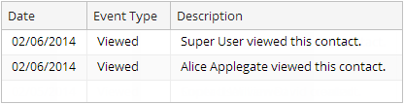
Row iterator: next object processed
Row
Row
HistoryEntry
ROW widget
CELL widget
CELL widget
CELL widget
Notes:
The PCF architecture has several different types of iterators, including:
Menu item iterators, which take a set of objects and generate one menu item for each.
Panel iterators, which take a set of objects and generate one panel (typically, one detail view) for each.
PolicyCenter coverage iterators, which take a set of coverages associated with a covered item (such as a vehicle) and generate one coverage input for each coverage.
<number>

Slide 12
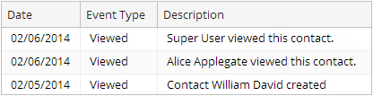
Row iterator: final object processed
Row
Row
Row
ROW widget
CELL widget
CELL widget
CELL widget
Notes:
The PCF architecture has several different types of iterators, including:
Menu item iterators, which take a set of objects and generate one menu item for each.
Panel iterators, which take a set of objects and generate one panel (typically, one detail view) for each.
PolicyCenter coverage iterators, which take a set of coverages associated with a covered item (such as a vehicle) and generate one coverage input for each coverage.
<number>

Slide 13

Resuable PCF file or inline widget
List View Panel PCF file
ListViewPanel widget
Resuable PCF file
Takes a root object
File name ends with LV
Inline widget, not reusable
Inherits parent object
Exercise control over all elements
List View Panel PCF
Notes:
When a container such as a list view panel is a top-level container, it is reusable. A top-level container is a PCF file. If the container is likely to be needed in multiple places, create a PCF file for the container. A List View Panel is PCF file that is ideal for multiple references. Other PCF files can reference the reusable container using a reference widget. In TrainingApp, the ABContactHistoryPage contains a Screen with a Panel Ref that references ABContactHistoryLV. PanelRef widgets are discussed later in this lesson.
When a container such as list view panel is declared as an inline child container, it is not reusable. Other containers cannot reference an inline container. A ListViewPanel widget is defined in a Screen, Card View Panel, or a List Detail Panel. It is possible to define a variable object for an ListViewPanel widget, but this is uncommon. A ListViewPanel widget inherits the root object associated with its parent.
<number>

Slide 14
List view panel fundamentals
Create list view panels
Reference list view panels
Notes:
<number>

Slide 15
Steps to create a List View Panel PCF
Create the List View Panel PCF file
Specify the required variables
Specify additional properties
Add row iterator to list view panel
Add row to row iterator
Add cell widgets to row
Deploy PCFs
* Slides do not cover the details of creating an inline List View Panel. See notes.
Notes:
Inline list view panel
1. Add the ListViewPanel widget to the parent container
2. Optionally specify additional properties
4. Add a row iterator widget
5. Add a row widget
6. Add cell widgets
7. Deploy PCFs
<number>

Slide 16
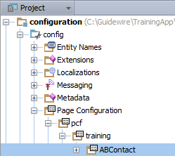
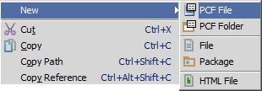
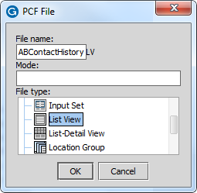
Step 1: Create a list view panel PCF
"LV" appended to file name
In Project View, select a PCF Folder in …\config\ Page Configuration\pcf\
Context menu → New → PCF File
Enter the File Name and select List View as the file type in PCF File dialog
Notes:
The initial list view panel always displays an error because every list view panel needs a row element. A newly created list view panel is empty.
Inline list view panels
To create an inline list view panel, find the ListViewPanel widget in the PCF Editor toolbox. Drag the ListViewPanel widget onto an existing screen, list detail panel, or card view panel.
<number>

Slide 17
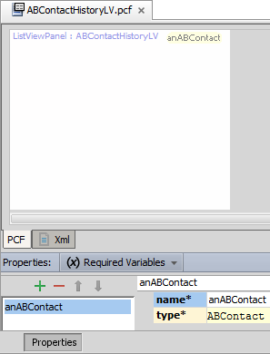
Step 2: Specify required variable(s)
Required Variables tab
Defines data object variable name and type
Example: anABContact is of type ABContact
Object data can be
Data backed (database)
Virtual property
Container data comes from the required variable object(s)
Referred to as root object
Notes:
Most container widgets have at least one required object that contains data fields. One way to think of this is that there is at least one root object for a given container. Root objects must be specified on the list view panel's Required Variables tab.
The initial list view panel always displays an error because every list view panel needs a row element. A newly created list view panel is empty. In the slide example, the screenshot has been modified to not show the error.
Inline list view panels
You do not need to specify root objects for inline list view panel. Because an inline list view panel can have only one parent container, it automatically inherits the root objects of its parent.
<number>

Slide 18
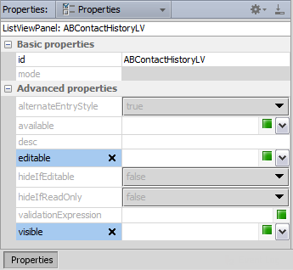
Step 3: Specify additional properties
Editable
Makes container and children widget editable
An explicit editable property for list view panel
Visible
Shows container and all children
If false, then hidden
Blank is default and means that the property inherits the value from parent container or location
Notes:
There are two states that a list view panel can be in: edit mode and read-only mode. If the editable property for a list view panel is true (or blank, which defaults to true), then the list view panel can be put into either read-only mode or edit mode. If the editable property for a list view panel is false, then the list view panel cannot be put into edit mode. It is always in read-only mode.
Inline list view panels
This step is the same for standalone and inline list view panels.
<number>

Slide 19
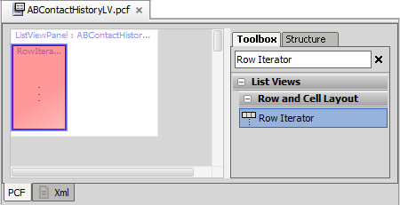
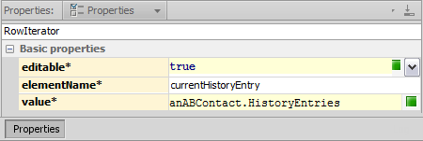
Step 4: Add row iterator to list view panel
editable= false
child cells not editable
elementName= current HistoryEntry
Symbol name for cell object
anABContact. HistroryEntries
root object array for row iterator
Notes:
In the slide example, the RowIterator has already been placed in the ListViewPanel in the PCF editor canvas. The Properties window shows the Properties tab. Some attributes in the Basic properties have been removed. An asterisk denotes a required property. RowIterator widgets have three required properties: editable, elementName, and value.
In the slide example…
Editable is false and the cell value cannot be edited.
The name of the symbol used to reference the object currently being processed is currentHistoryEntry.
The object set to be processed is anABContact's HistoryEntries array.
Inline list view panels
This step is the same for standalone and inline list view panels.
<number>

Slide 20
Row Iterator required properties
ABContact as root object
value
Set of objects (array or query result) to iterator over
editable
Editability of cells
elementName
For object currently being processed, cell widgets refer to this symbol
value= anABContact.HistoryEntries
HistoryEntry
HistoryEntry
HistoryEntry
ROW
elementName= currentObj
CELL
currentObj. CreateTime
CELL
currentObj. EventType
CELL
currentObj. Description
Notes:
Each cell widget inside the row widget is used to render data for multiple objects. For example, the first cell in the diagram above renders the CreateDate field for all three HistoryEntry objects in the array. The cell widget must therefore be bound to an abstract name that references each object in the array one at a time. The Element Name property of the row iterator defines what this name is. The value you select for the Element Name property is arbitrary, but whatever value you select must be used by the cell widgets in the row iterator.
To improve readability, use element names such as "current<object>" or "this<object>".
<number>

Slide 21
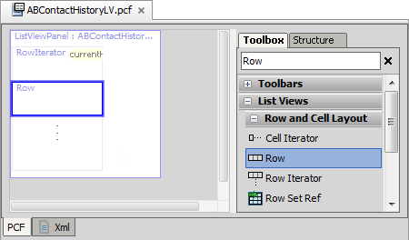
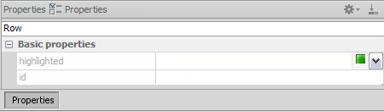
Step 5: Add Row to RowIterator widget
Row is required
Not necessary to define properties in most cases for row
Notes:
In the slide example, the Row has already been placed in the Row Iterator in the PCF editor canvas. The Properties window shows the Properties tab.
Inline list view panels
This step is the same for standalone and inline list view panels.
<number>

Slide 22
Data values and cell widgets
Select the most appropriate cell widget for the data
Examples
Date cell for date
Radio Button for bit
Text Cell for varchar
Typekey Cell for typekey
Data type | Cell Widget
varchar, integer, decimal | Text Cell
varchar, shorttext, mediumtext, longtext, text | Text Area Cell
date, datetime | Date Cell
money | MonetaryAmount Cell
bit | Check Box Cell Radio Button Cell
foreign key | Cell
foreignkey + array | Range Cell Range Radio Button Cell
typekey | Typekey Cell
Notes:
<number>

Slide 23
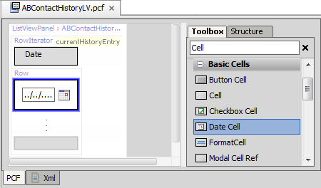
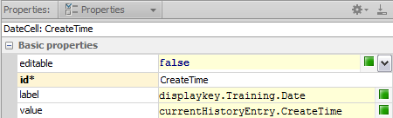
Step 6: Add cell widgets to row
editable
default is false
Id
required, but only unique to row
label
specifies column header
value
reference to iterator's element name and object property
Notes:
In the slide example, the DateCell widget has already been placed in the Row in the PCF editor canvas. The DateCell widget offers additional formatting options for dates and times.
The Properties window shows the Properties tab. Some attributes in the Basic properties have been removed. An asterisk denotes a required property. Cell input widgets require a unique ID value. However, this value need only be unique to the inputs in the Row.
A cell widget is inside row iterator, which is used to process multiple rows. A cell's value property must reference row iterator's element name. The label property specifies the label for column header.
Inline list view panels
This step is the same for standalone and inline list view panels.
<number>

Slide 24
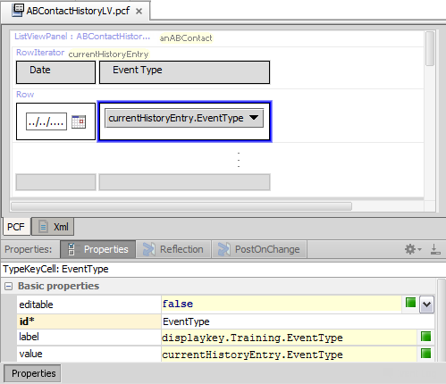
Example: Second cell
Add cell to row
Order determines default column order
Use the best widget for data type
Example:
EventType is a typekey for the HistoryEvent Type typelist
Use the TypeKey cell
Notes:
In the slide example, the EventType Cell widget has already been placed in the Row in the PCF editor canvas. The Properties window shows the Properties tab. Some attributes in the Basic properties have been removed. An asterisk denotes a required property. Cell input widgets require a unique ID value. However, this value need only be unique to the inputs in the Row.
<number>

Slide 25
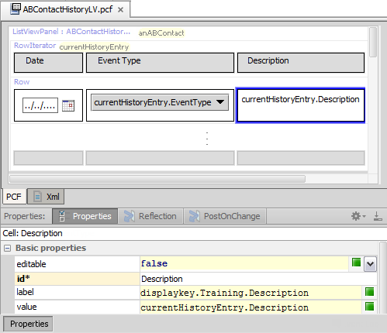
Example: Third cell
Add cell to row
Order determines default column order
Use the best widget for the field data
Example
Description is varchar(160) data
Use the Text cell
Notes:
<number>

Slide 26
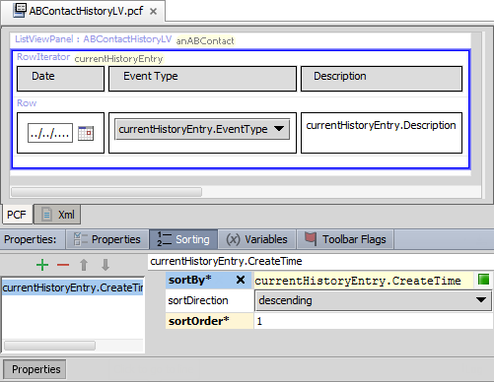
Row iterator sorting
To define the default behavior of the row iterator sort, use the Sorting properties tab
sortBy
Specify field
sortDirection
Specify ascending or descending
sortOrder
Specify sort precedence
Notes:
The row iterator can sort the objects (elementName property) in the array (value property). To define the default sorting criteria, use the row iterator Sorting properties tab to specify the sorting criteria.
For each sort criterion, you must specify the sortBy value, the direction of the sort (ascending or descending), and precedence of the criteria (the sortOrder value). It is possible to have multiple sort criterion. If a column has a sort criteria with sort order 1 (and the sortBy column is visible in the list), then it is initially rendered with an up-facing or down-facing arrow head next to the label. The direction of the arrow reflects the sortDirection value. Any criteria with a sort order of 2 or greater are rendered with an up-facing or down-facing double arrow head next to the header label.
For properties that are typecode fields, rows are sorted based on the priority and then name of the typecodes. For example, if a list of buildings includes a "BuildingType" column with possible values of "residential - single dwelling" (priority 10) and "residential - multiple dwelling" (priority 20) and the column has a defined ascending sort order, all "residential - single dwelling" buildings will be listed before any "residential - multiple dwelling" buildings.
You can create sort criterion that reference values not displayed in the list. For example, a list of history entries could be sorted by create date even though the create date isn't displayed in the list.
Users can override the defined sorting criteria for a row iterator column by clicking the column header in the user interface. It is possible to disable the user override by setting the enableSort property to false for a given cell widget. Cell widgets have sort properties, but setting these properties is not recommended because of performance issues. Whenever possible, adhere to the best practice of configuring sorting for the row iterator and then, if required, override the user interface behavior by setting enableSort for a given cell widget to false.
<number>

Slide 27
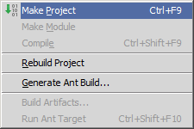
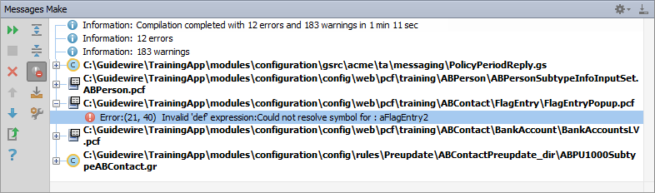
Make project to see all PCF errors
Build → Make Project
Compiles only modified files since the last compilation
Opens Messages (Make) window for build summary
Filter for errors
Great way to see all PCF errors
Notes:
Make Project: All the source files in the entire project that have been modified since the last compilation are compiled. Dependent source files, if appropriate, are also compiled. Additionally, the tasks tied to the compilation or make process on modified sources are performed.
<number>

Slide 28
Step 7: Deploy PCFs
Restart Server
Reload PCFs
PCFs read at server startup
ALT+SHIFT+L
Internal debug tools enabled
Internal Tools
Reload → Reload PCF Files
Page Configuration File
List View Panel PCF
Page Configuration File
List View Panel PCF
Notes:
It is also possible to reload PCF files using the Guidewire API and/or internal server tools. The Reload PCF command can be found on the Reload page in Internal Tools. To access Internal Tools, the EnableInternalDebugTools setting in the config.xml file must be set to true. The keystroke to open the Internal Tools page is ALT+SHIFT+T. In the tab bar, select Internal Tools --> Reload. On the Reload page, click the Reload PCF Files button. Both the keystroke ALT+SHIFT+L and the Reload PCF Files button call the same static method: gw.api.tools.InternalToolsUtil.reloadPCFs().
Inline list view panels
This step is the same for standalone and inline list view panels. However, for inline list view panels, only the location PCF files get deployed.
<number>

Slide 29
List view panel fundamentals
Create list view panels
Reference list view panels
Notes:
<number>

Slide 30
Referencing list view panels
Screen
A reference widget in a parent container references a PCF File as an embedded child container
A PanelRef widget can reference:
Detail View Panel
List View Panel
Card View Panel
List Detail Panel
A List View Input in a Detail View Panel can reference:
List View Panel
Card View Panel / List Detail Panel
Panel Ref
Detail View Panel
List View Input
List View Panel
Input Set
Atomic Widgets
Notes:
List view panels can be referenced by four types of containers: screens, card view panels, list detail panels, and detail view panels.
The methods for referencing a list view panel in a screen, card view panel or list detail panels is identical: you use a PanelRef widget. To embed a list view panel in a detail view panel you use a List View Input widget.
<number>

Slide 31
Reference a List View Panel
Screen, Card View Panel, or List Detail Panel
List View Input
Add panel ref
Specify def property
Add toolbar
Deploy PCFs
Add list view input
Specify def property
Add toolbar
Deploy PCFs
Notes:
<number>

Slide 32
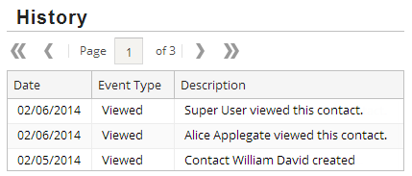
Panel Ref
Panel Ref
Toolbar
List View Panel
A Panel Ref includes a reference to a "panel" container
Card View Panel, Detail View Panel, List Detail Panel, List View Panel, or Panel Set
Optionally supplies referenced panel with Title, Toolbar, Help Text
If applicable, a toolbar automatically applies paging
Notes:
A Panel Ref requires a reference to a panel such as a Detail View Panel, List View Panel, Panel Set or Card View Panel. A Panel Ref supplies the referenced panel with title, toolbar or instructional text.
<number>

Slide 33
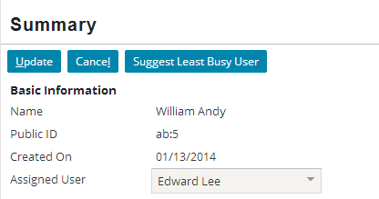
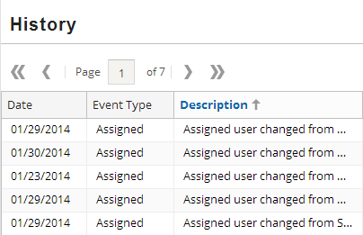
Toolbars
A toolbar is row of data action buttons and other widgets associated with a specific container widget
Direct placement
Screen
Panel Ref
List View Input
Referenced containers
Card View Panel
Detail View Panel
List Detail Panel
List View Panel
Input Set not applicable
Notes:
A toolbar is a row of widgets associated with a container widget that lets the user take action on the data in the container widget.
A toolbar can be directly add to a Screen, Panel Ref, or List View Input. Toolbars can also be associated with Detail View Panels, Card View Panels, List Detail Panels, and List View Panels. However, there is no direct placement or reference with an Input Set. Typically, an Input Set is referenced or placed in an Input Column in a Detail View Panel.
A toolbar has usually has button widgets such as Edit Buttons. When a toolbar is associated with a list view panel, the toolbar may not have any button widgets. In this specific case, the toolbar association may be required to provide button paging controls. Paging button controls allow users to view the list view rows in sizable chunks and "page" through the results. A user can move to the first, last, previous and next page. A user can also specify a specific page number to view.
<number>

Slide 34
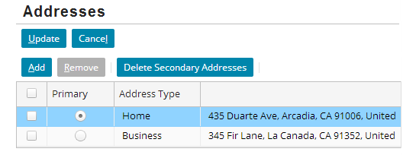
Toolbar placement: Panel Ref
Toolbar
Panel Ref
List View Panel
A Panel Ref includes a reference to a panel container
Card View Panel, Detail View Panel, List Detail Panel, List View Panel, or Panel Set
Optionally supplies referenced panel with
Title, Toolbar, Instructional text
Notes:
There are three places that you can place a toolbar: Screen, Panel Ref, and List View Input.
A Panel Ref requires a reference to a panel such as a Detail View Panel, List View Panel, Panel Set or Card View Panel. A Panel Ref supplies the referenced panel with title, toolbar or instructional text.
<number>

Slide 35
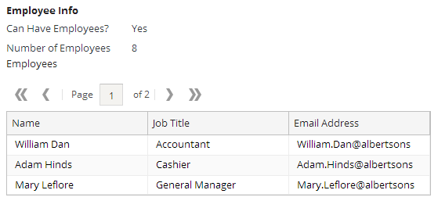
Toolbar placement: List View Input
List View Input
Toolbar
List View Panel
A List View Input references a List View Panel and supplies it with an optional toolbar
If applicable, a toolbar automatically applies paging
Notes:
There are three places that you can place a toolbar: Screen, Panel Ref, and List View Input.
A ListViewInput element references a List View Panel and supplies it with an optional toolbar. Configuring List View Panels is covered later in this course. In the slide example, the page is in read-only mode. The toolbar automatically adds paging of the list in both read-only and edit modes.
<number>

Slide 36
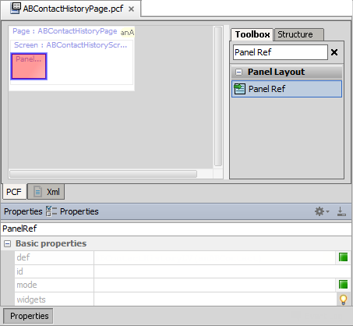
Step 1: Add panel ref
Add a PanelRef widget to the parent container
Panel Ref requires a def property value
Notes:
A PanelRef widget can reference a list view panel. To reference a list view panel from a parent container, add a Panel Ref in the appropriate place in the parent container.
In the slide example, the Panel Ref has already been placed in the Screen in the PCF editor canvas. The Properties window shows the Properties tab of the Panel Ref.
<number>

Slide 37
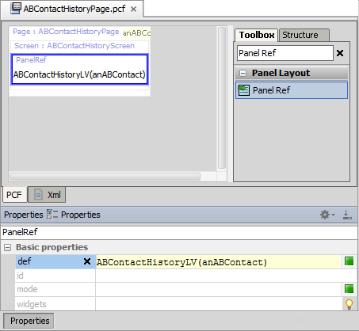
Step 2: Reference the list view panel
Set the def property to specify the list view panel
Pass the required root object type as an argument
List View Panel
Root object
Notes:
In the PanelRef's def property, specify the list view panel. Specify the required object(s) to pass to the list view panel in parentheses.
In the slide example, ABContactHistoryPage defines a root object named anABContact. ABContactHistoryPage contains a newly added Panel Ref. The Panel Ref requires a value for the def property. The def property references the list view panel named ABContactHistoryLV. The def property passes the anABContact root object as an argument to ABContactHistoryLV.
<number>

Slide 38
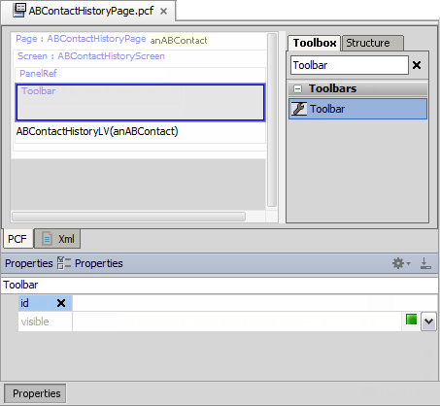
Step 3: Add toolbar for paging
Add a Toolbar to PanelRef widget
Toolbar widget provides paging controls for list view panel
Notes:
In the slide example, the Toolbar has already been placed in the PanelRef in the PCF editor canvas. The Properties window shows the Properties tab for the Toolbar.
When a toolbar is associated with a list view panel, the configuration results in the toolbar providing paging button controls in the user interface.
Paging button controls allow users to view the list view rows in sizable chunks and "page" through the results. A user can move to the first, last, previous and next page. A user can also specify a specific page number to view.
<number>

Slide 39
List View Input
List View Input
Toolbar
List View Panel
A List View Input references a List View Panel for a Detail View Panel
An optional toolbar automatically applies paging
Notes:
A ListViewInput element references a List View Panel and supplies it with an optional toolbar. A List View Input allows for an List View Panel to be placed in a Detail View Panel.
In the slide example, the page is in read-only mode. The toolbar automatically adds paging of the list in both read-only and edit modes.
<number>

Slide 40
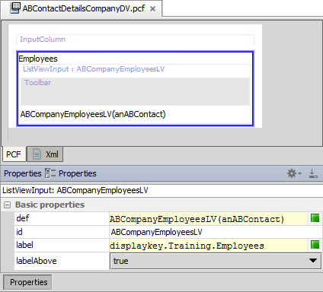
List view input properties
def
references list view panel
label
Value to display in UI
Use displaykey
labelAbove
Affects label position
True is above
False is left of list view
Notes:
<number>

Slide 41
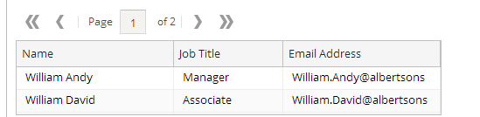
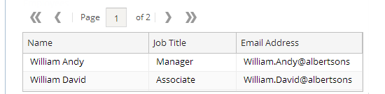
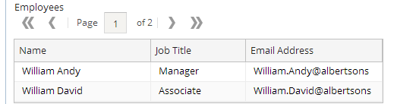
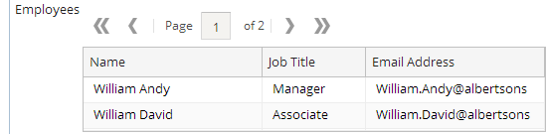
Properties: label and labelAbove
Default
No label
labelAbove=true
Offset
No label
labelAbove=false
Above
label
labelAbove=true
Offset Above
label
labelAbove=false
Notes:
When labelAbove is set to false, the application offsets the list view from the left side of the input column to make room for the label.
If you do not plan to use a label for the list view, you may want to set the labelAbove to true to make better use of the space on the screen.
<number>

Slide 42
Make project to see all PCF errors
Build → Make Project
Compiles only modified files since the last compilation
Opens Messages (Make) window for build summary
Filter for errors
Great way to see all PCF errors
Notes:
Make Project: All the source files in the entire project that have been modified since the last compilation are compiled. Dependent source files, if appropriate, are also compiled. Additionally, the tasks tied to the compilation or make process on modified sources are performed.
<number>

Slide 43
Step 4: Deploy PCFs
Restart Server
Reload PCFs
PCFs read at server startup
ALT+SHIFT+L
Internal debug tools enabled
Internal Tools
Reload → Reload PCF Files
Page Configuration File
List View Panel PCF
Page Configuration File
List View Panel PCF
Notes:
It is also possible to reload PCF files using the Guidewire API and/or internal server tools. The Reload PCF command can be found on the Reload page in Internal Tools. To access Internal Tools, the EnableInternalDebugTools setting in the config.xml file must be set to true. The keystroke to open the Internal Tools page is ALT+SHIFT+T. In the tab bar, select Internal Tools --> Reload. On the Reload page, click the Reload PCF Files button. Both the keystroke ALT+SHIFT+L and the Reload PCF Files button call the same static method: gw.api.tools.InternalToolsUtil.reloadPCFs().
<number>

Slide 44
Describe the functionality of list view panels
Create a new list view panel
Create and modify row iterator, row, and cell widgets
Reference list view panels
Notes:
<number>

Slide 45
In a list view panel:
What type of widget displays individual fields of data?
What type of widget organizes the individual fields of data?
Assume you have a list view panel with "anABContact" as the root object. The list view panel displays the contact's addresses.
What would the row iterator's "value" property be set to?
What would the row iterator's "element name" be set to?
What other widgets would make use of the element name?
A list view typically needs a toolbar, even if it is read-only. Why?
In what way is embedding a list view panel in a detail view panel different from embedding a list view panel in a screen?
Notes:
Answers
1a) Cell widgets
1b) Row widgets
2a) anABContact.Addresses (assuming that the name of the addresses array is "Addresses")
2b) The value is arbitrary, but it would probably be set to something like "currentAddress".
2c) The cell widgets inside the row iterator's row. For example, a cell displaying the street would have a value of "currentAddress.Street".
3) The toolbar is needed for the paging controls. These controls are used to view each page of rows if the number of rows is greater than what can be displayed at one time.
4) To embed a list view panel in a detail view panel , use a ListViewInput widget. To embed a list view panel in a screen (or card view panle or list detail panel , you use a PanelRef widget.
<number>

Slide 46
Notes:
<number>

